Slide 1





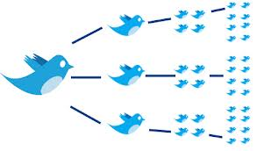


Social Media Analytics Fake Posts & Network Characteristics MSBA, Spring 2019, Feb 25 (Session 5)
Dr. Anitesh Barua
David Bruton Jr. Centennial Chair Professor of Business
Distinguished Fellow, INFORMS Information Systems Society
Stevens Piper Foundation Professor
University of Texas Distinguished Teaching Professor
Associate Director, Center for Research in e-Commerce
McCombs School of Business, University of Texas at Austin
Email: aniteshb@gmail.com

Slide 2
Fake Posts
What is a fake post?
Was not too difficult to detect fake reviews from content
Why is it difficult to detect now?
Notes:
Fake post: False information which is verifiable and needs to be intentional
Troll – different than fake post. Trolls may write real posts
Spam -

Slide 3

“Told ya, it’s all Fake!”
When machine learning generates reviews
Easily my favorite Italian restaurant. I love the taster menu, everything is amazing on it. I suggest the carpaccio and the asparagus. Sadly it has become more widely known and becoming difficult to get a reservation for prime times.
My family and I are huge fans of this place. The staff is super nice and the food is great. The chicken is very good and the garlic sauce is perfect. Ice cream topped with fruit is delicious too. Highly recommended!
I come here every year during Christmas and I absolutely love the pasta! Well worth the price!
Excellent pizza, lasagna and some of the best scallops I've had. The dessert was also extensive and fantastic.
The food here is freaking amazing, the portions are giant. The cheese bagel was cooked to perfection and well prepared, fresh & delicious! The service was fast. Our favorite spot for sure! We will be back!
I have been a customer for about a year and a half and I have nothing but great things to say about this place. I always get the pizza, but the Italian beef was also good and I was impressed. The service was outstanding. The best service I have ever had. Highly recommended.
1, 3 & 4 are real, 2, 5 and 6 are fake

Slide 4
They Come in Many Flavors
~ 19 million bot accounts tweeted in support of either Trump or Clinton in 2016
> 1,000 paid Russian trolls spread “fake news” on Hillary Clinton
CNN mobile app received 100s of thousands of 1-star reviews after the network’s treatment of a certain Reddit user
The Boca Raton Resort hotel got a huge number of negative reviews (1000s) after a Youtube star angry at his treatment rallied his fanbase to retaliate online

Slide 5
Detecting Fake Posts
Can use content, users characteristics and networks
Using content is fairly unreliable today
User characteristics?
Network characteristics?

Slide 6
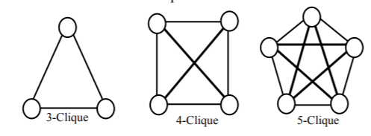
Of “Cliques” and Cores
Definition of an n-clique?
What is the significance?
Notes:
Clique: is a number, maximum number of nodes fully connected to each other. Maximal sub-graph. 2 is minimum
Can be used for spam detection and fake detection

Slide 7
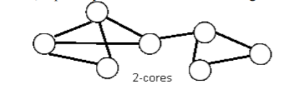
K-core
A 2-core
Definition of a k-core?
What is the significance?
Notes:
Core: More relaxed than clique. In a clique, everyone has to be connected to each other. Each person is connected to k-people. In a 2-core network, you need to be connected to atleast 2 people
Subset of overall network

Slide 8
Hypotheses
Spammers have larger cores than non-spammers
Spammers have larger cliques than non-spammers
Spammers have higher network density

Slide 9
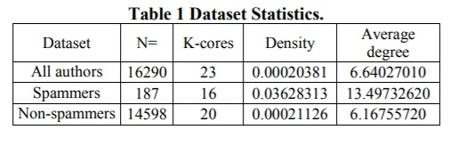
Are Spammers’ Networks Different?
Source: Wang et al. (2016)
Notes:
- Non spammers are connected to max of 20 people

Slide 10
Data Sources
BuzzFeedNews
Sample of news published in Facebook from 9 news agencies over a week close to the 2016 U.S. election.
Every post and the linked article were fact-checked claim-by-claim by 5 BuzzFeed journalists.
Further enriched by relevant metadata
LIAR: 12,836 human-labeled short statements
Labels for news truthfulness are fine-grained multiple classes: pants-fire, false, barely-true, half-true, mostly true, and true.
BS Detector
CREDBANK: This is a large scale crowdsourced dataset of approximately 60 million tweets that cover 96 days starting from October 2015. All the tweets are broken down to be related to over 1,000 news events, with each event assessed for credibilities by 30 annotators from Amazon Mechanical Turk.
Source: Wang et al. (2016)

Slide 11
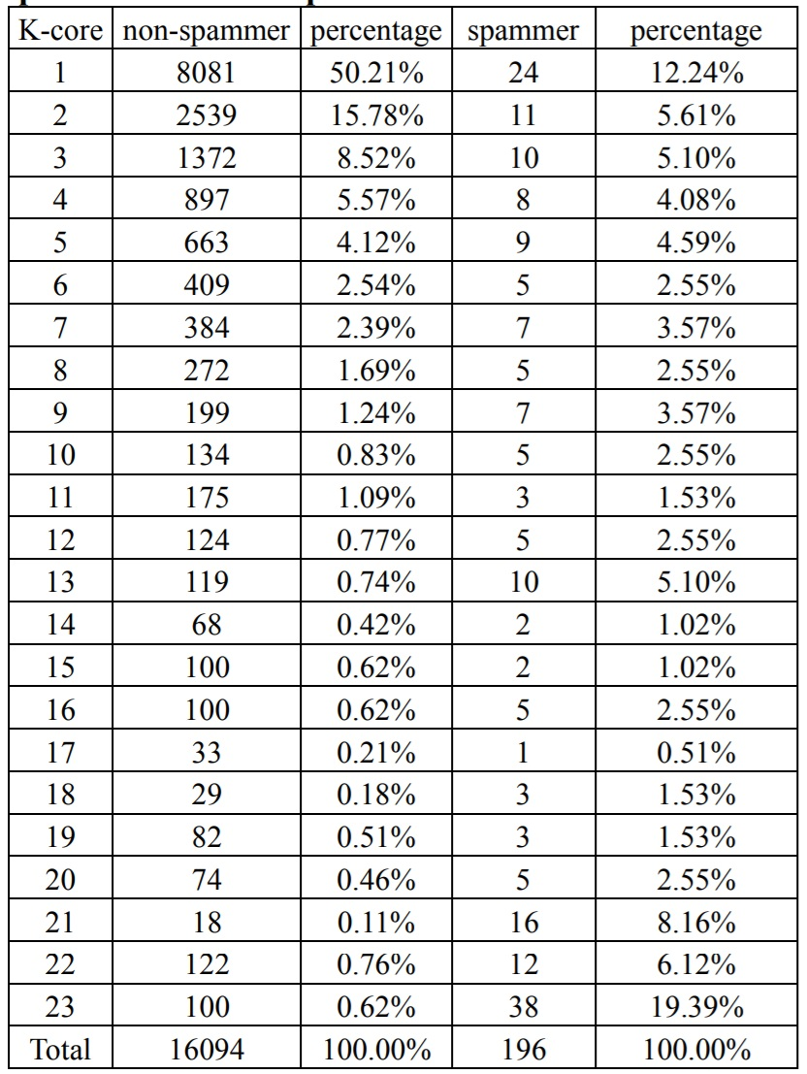
Birds of the Same Feather?
Source: Wang et al. (2016)
Notes:
- Spammers are connected to many people, non-spammers aren’t connected to many

Slide 12
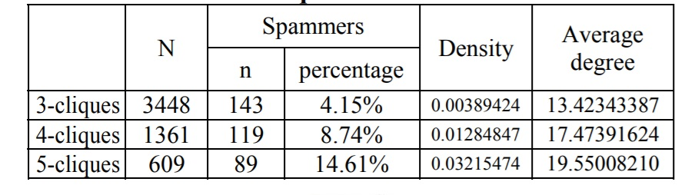
What About Cliques?
Source: Wang et al. (2016)

